Slide 1
Installing Windows Server
IOS110

Slide 2
Objectives
Plan and make the appropriate preparations for installing Windows Server
Understand the different installation methods used and install Windows Server
Perform Initial Configuration Tasks
Activate Windows Server
Describe automated installations
Install service packs
Troubleshoot installation problems
Uninstall Windows Server

Slide 3
Pre-installation Tasks
Identify the hardware requirements and check hardware compatibility
Determine disk partitioning options
Understand the file system
Determine upgrade options
Plan user licensing
Determine domain or workgroup membership
Choose a computer name
Install Server Core or Server with GUI
Identify the server roles to implement

Slide 4
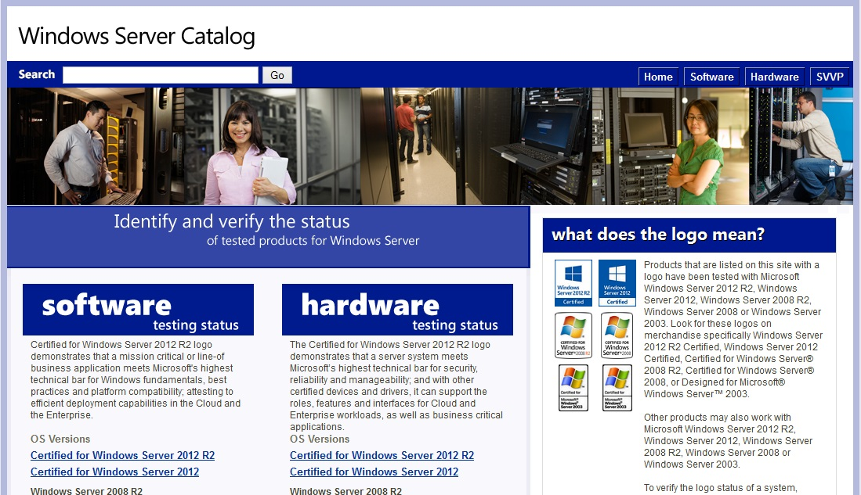
Identifying Hardware Requirements and Determining Compatibility
Use minimum hardware requirements as a guide
Consider the Server Roles to be implemented
Consider the load on the server
Select hardware from Catalog of Tested Products
www.windowsservercatalog.com

Slide 5
Determining Disk Partitioning Options
Installation program identifies current disk configuration
Use existing configuration or modify during the installation
Disk partitioning can be modified after the installation using administration tools

Slide 6
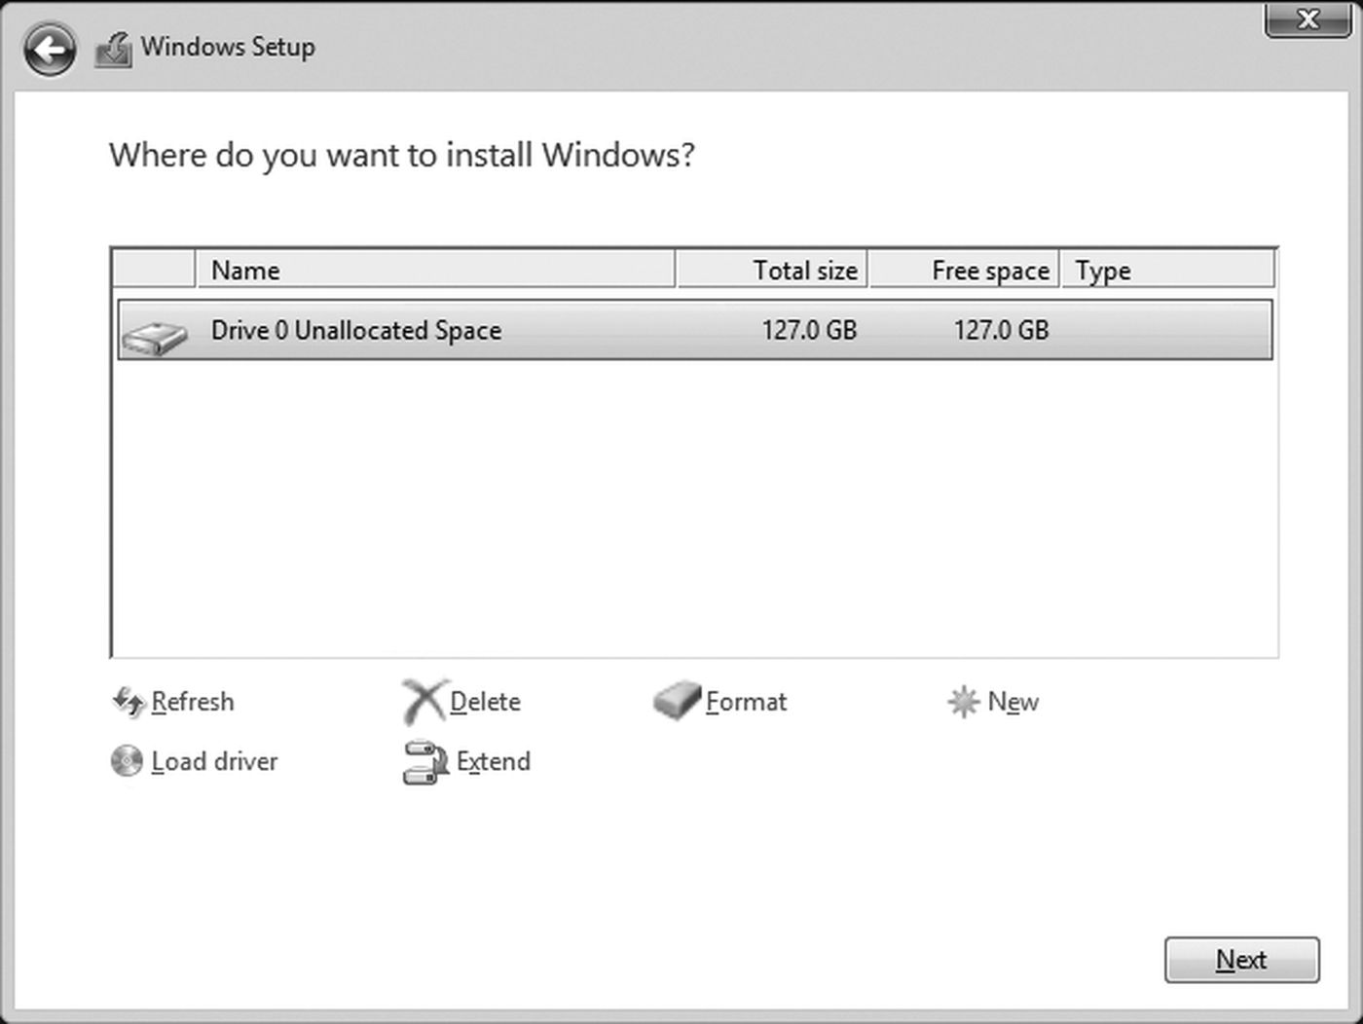
Existing Disk Configuration

Slide 7
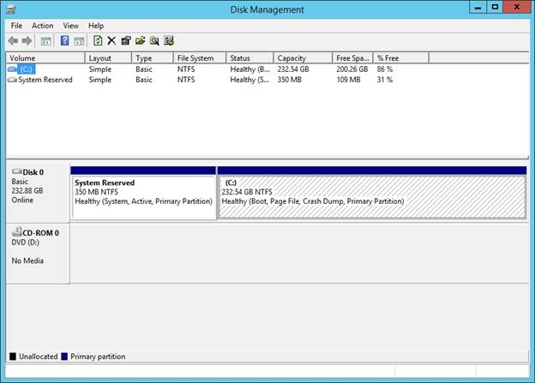
Modify Disk Configuration After Install
http://www.windowsnetworking.com/articles-tutorials/windows-server-2012/first-look-windows-server-2012-r2-storage-part1.html

Slide 8
Choosing a File System
NTFS
ReFS (Resilient File System)
NTFS remains the file system of choice for the operating system boot volume as well as any other general needs for data storage.
New File System with 2012
Not a direct replacement for NTFS as it does not support all the same features
Very resilient, no matter what the underlying storage scenario
Supports HUGE volumes of data
Notes:
ReFS
http://technet.microsoft.com/en-ca/library/hh831724.aspx
NTFS
http://technet.microsoft.com/en-us/library/dn466522.aspx
http://blogs.technet.com/b/askpfeplat/archive/2013/01/02/windows-server-2012-does-refs-replace-ntfs-when-should-i-use-it.aspx

Slide 9
Understanding NTFS
The native/preferred Windows Server file system
NTFS features include:
Local security through file and folder permissions
Compression
Disk quotas
Encryption
Indexing
POSIX.1 support
Journaling
Large volume capacity – 16TB
Notes:
Portable operating system interface (POSIX)
A set of standards designed to enable portability of applications from one computer system to another
Journaling by a file system means that it tracks changes to files and keeps a record of these changes in a separate log file

Slide 10
Clean Install, Upgrade or Migrate?
Clean installation requires deleting the previous operating system, or starting on a new computer.
Always creates the most stable environment
Upgrade means moving from your existing operating system to Windows Server 2012 R2, while staying on the same hardware.
In-place upgrade, upgrades only the operating system files while maintaining installed software, settings, configuration and data
Migration means moving from your existing operating system to Windows Server 2012 R2 by transferring to a different set of hardware.
Use migration tools to transfer the software, settings, configuration and data to a new installation on an new machine (side by side)

Slide 11
Upgrading to Windows Server 2008 R2
If you are running: | You can upgrade to these editions:
Windows Server 2008 R2 Datacenter with SP1 | Windows Server 2012 R2 Datacenter
Windows Server 2008 R2 Enterprise with SP1 | Windows Server 2012 R2 Standard or Windows Server 2012 R2 Datacenter
Windows Server 2008 R2 Standard with SP1 | Windows Server 2012 R2 Standard or Windows Server 2012 R2 Datacenter
Windows Web Server 2008 R2 with SP1 | Windows Server 2012 R2 Standard
Windows Server 2012 Datacenter | Windows Server 2012 R2 Datacenter
Windows Server 2012 Standard | Windows Server 2012 R2 Standard or Windows Server 2012 R2 Datacenter
Notes:
If you do not see your current server edition listed in the “If you are running” column, it cannot be upgraded (in place) to 2012 R2. A clean installation must be done.

Slide 12
Planning Licensing
Edition Feature comparison Licensing model Server Pricing*
Datacenter Unlimited virtual OSE Processor + CAL**
All features $6,155
Standard Two virtual OSE
All features Processor + CAL** $882
Essentials 2 processor
One OSE
Limited features Server
25 user limit $501
Foundation 1 processor
Limited features Server
15 user limit OEM Only **Client Access Licenses (CALs) are required for every user or device accessing a server.
Notes:
OSE: Operating System Environment

Slide 13
Determining Domain or Workgroup Membership
Workgroup is default
Requirements for adding the computer to a domain:
You must have administrative rights in the domain
Provide the DNS name of the domain you want to join
One domain controller and a DNS server must be online before you can join the domain

Slide 14
Choosing a Computer Name
Default – randomly generated name
Some organizations have a predetermined naming scheme for computers on their network
Microsoft’s recommendations :
maximum length is 63 characters
Unique name on the network
If no DNS server, use only standard Internet characters
If a DNS server is present, use standard Internet characters plus additional characters such as $, %, &

Slide 15
Server Core or Server with GUI
“Server Core Installation” option reduces the space required on disk, the potential attack surface, and especially the servicing requirements
Server Core installation is now the default
you can freely switch between these options at any time after installation
one approach might be to initially install the Server with a GUI option, use the graphical tools to configure the server, and then later switch to the Server Core Installation option.

Slide 16
Basic Server Roles
File and Storage Services Role
Print and Document Services Role
DHCP Server Role
DNS Server Role
Web Server (IIS) Role
Application Server Role
Active Directory Domain Services Role
Windows Deployment Services Role
Hyper-V Role
Notes:
http://technet.microsoft.com/en-ca/library/hh831669.aspx
File and Storage Services
File and Storage Services includes technologies that help you set up and manage one or more file servers, which are servers that provide central locations on your network where you can store files and share them with users. If your users need access to the same files and applications, or if centralized backup and file management are important to your organization, you should set up one or more servers as a file server by installing the File and Storage Services role and the appropriate role services.
The File and Storage Services role and the Storage Services role service are installed by default, but without any additional role services. This basic functionality enables you to use Server Manager or Windows PowerShell to manage the storage functionality of your servers. However, to set up or manage a file server, you should use the Add Roles and Features Wizard in Server Manager or the Install-WindowsFeature Windows PowerShell cmdlet to install additional File and Storage Services role services, such as the role services discussed in this topic.
Print and Document Services
Print and Document Services enables you to centralize print server and network printer tasks. With this role, you can also receive scanned documents from network scanners and route the documents to a shared network resource, Windows SharePoint Services site, or email addresses.
DHCP Services
DHCP is a client-server technology that enables DHCP servers to assign, or lease, IP addresses to computers and other devices that are enabled as DHCP clients. When you deploy DHCP servers on your network, you can automatically provide client computers and other IPv4- and IPv6-based network devices with valid IP addresses and the additional configuration parameters these clients and devices need. The DHCP Server service in Windows Server® 2012 includes support for policy based assignment and DHCP failover.
DNS Services
DNS is a hierarchical, distributed database that contains mappings of domain names to various types of data, such as IP addresses. DNS enables you to use friendly names, such as www.microsoft.com, to easily locate computers and other resources on a TCP/IP-based network. The DNS service in Windows Server® 2012 adds enhanced support for DNS Security Extensions (DNSSEC), including online signing and automated key management. Web Server (IIS)
The Web Server (IIS) role in Windows Server 2012 provides a secure, easy-to-manage, modular and extensible platform for reliably hosting websites, services, and applications. With IIS 8 you can share information with users on the Internet, an intranet, or an extranet. Administrators can use the Web Server (IIS) role to set up and manage multiple websites, web applications, and FTP sites.
Application Server
Application Server provides an integrated environment for deploying and running custom, server-based business applications.The Application Server role is recommended when you are deploying a business application that was developed within your organization and when the developer has indicated that specific role services are required. For example, your organization may have an order-processing application that accesses customer records that are stored in a database. The application accesses the customer information through a set of WCF Web services. In this case, you can configure one Windows Server computer as an application server, and you can install the database on the same computer or on a different computer.
Active Directory Domain Services (ADDS)
By using the Active Directory® Domain Services (AD DS) server role, you can create a scalable, secure, and manageable infrastructure for user and resource management, and provide support for directory-enabled applications.
AD DS provides a distributed database that stores and manages information about network resources and application-specific data from directory-enabled applications. A server that is running AD DS is called a domain controller. Administrators can use AD DS to organize elements of a network, such as users, computers, and other devices, into a hierarchical containment structure. The hierarchical containment structure includes the Active Directory forest, domains in the forest, and organizational units (OUs) in each domain.
Windows Deployment Services (WDS)
Windows Deployment Services (WDS) enables you to deploy Windows operating systems over the network, which means that you do not have to install each operating system directly from a CD or DVD.
Allows network-based installation of Windows operating systems, which reduces the complexity and cost when compared to manual installations.
Supports deploying images for mixed environments including Windows 7and Windows Server 2008 R2 through Windows 8.1and Windows Server 2012 R2.
Uses standard Windows Setup technologies including Windows Preinstallation Environment (Windows PE), .wim files, and image-based setup.
Transmits data and images by using multicast functionality.
Allows you to create images of a reference computer using the Image Capture Wizard, which is an alternative to the ImageX tool.
Allows you to add driver packages to the server and configure them to be deployed to client computers along with the install image.
Hyper-V
The Hyper-V technology virtualizes hardware to provide an environment in which you can run multiple operating systems at the same time on one physical computer. Hyper-V enables you to create and manage virtual machines and their resources. Each virtual machine is an isolated, virtualized computer system that can run its own operating system. The operating system that runs within a virtual machine is called a guest operating system
Microsoft recommends that you do not install other roles with Hyper-V. Any other roles that you need the physical computer to perform are better off implemented within one of the virtual machines you create with Hyper-V.

Slide 17
Preparing to Install
Before you start setup:
Disconnect UPS devices.
Back up your servers.
Disable your virus protection software.
Provide mass storage drivers.
Be aware that Windows Firewall is on by default.
Notes:
Disconnect UPS devices. If you have an uninterruptible power supply (UPS) connected to your destination computer, disconnect the serial cable before running Setup. Setup automatically attempts to detect devices that are connected to serial ports, and UPS equipment can cause issues with the detection process. Back up your servers. Your backup should include all data and configuration information that is necessary for the computer to function. It is important to perform a backup of configuration information for servers, especially those that provide network infrastructure, such as Dynamic Host Configuration Protocol (DHCP) servers. When you perform the backup, be sure to include the boot and system partitions and the system state data. Another way to back up configuration information is to create a backup set for Automated System Recovery. Disable your virus protection software. Virus protection software can interfere with installation. For example, it can make installation much slower by scanning every file that is copied locally to your computer. Provide mass storage drivers. If your manufacturer has supplied a separate driver file, save the file to a floppy disk, CD, DVD, or Universal Serial Bus (USB) flash drive in either the root directory of the media or the amd64 folder. To provide the driver during Setup, on the disk selection page, click Load Driver (or press F6). You can browse to locate the driver or have Setup search the media. Be aware that Windows Firewall is on by default. Server applications that must receive unsolicited inbound connections will fail until you create inbound firewall rules to allow them. Check with your application vendor to determine which ports and protocols are necessary for the application to run correctly.

Slide 18
Windows Server Installation Methods
The primary installation methods are as follows:
DVD installation
Directly from ISO file (virtual machines)
Upgrade from older version (DVD)
Unattended installation with Windows Deployment Services (WDS)

Slide 19
DVD Installation
To start the installation from DVD:
Make sure the computer’s BIOS is set to boot first from the CD/DVD drive
Insert the Windows Server installation DVD
Power off the computer
Turn on the computer, and if necessary, press the key combination to boot from the CD/DVD drive
Follow the instructions for installing Windows Server

Slide 20
Upgrading from an older version of Windows Server
The general steps to begin an upgrade are as follows:
Boot the computer to use its current operating system
Insert the new Windows Server installation DVD
If you see the Autoplay window, click the option to Run setup.exe.
When you see the Install Windows window, click Install now
Follow the instructions for installing Windows Server

Slide 21
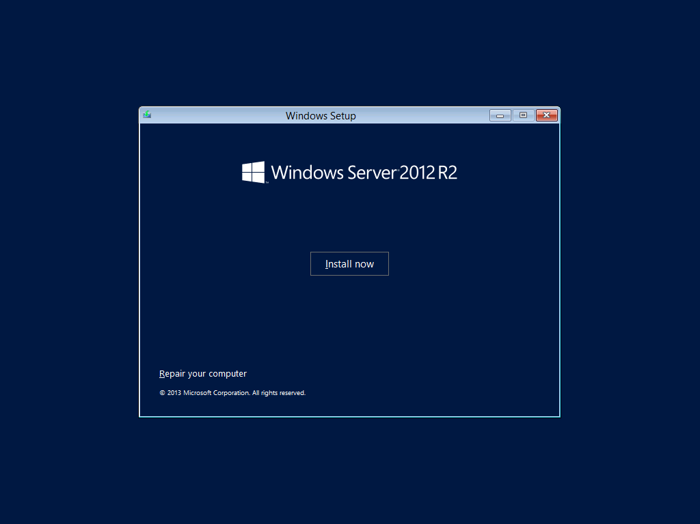
Starting the Installation

Slide 22
Installation for a Virtual Server Using Hyper-V
Almost the same as setting up a regular server, but first you need to go through the steps to set up a virtual server
Install from DVD or an ISO image

Slide 23
Installing Windows Server Core
The steps for installing Windows Server Core are nearly identical to the steps for Server with GUI
At the end of the installation process when you need to log on to the newly installed system, you will see only a command prompt window

Slide 24
Windows Deployment Services – WDS Role
designed to enable the installation of Windows operating systems on multiple computers
Unattended – no person needs to interact with the installation process
An installation DVD is not necessary
The installation files are sent over a network from the Windows Deployment Services server
licenses are required for all of the operating systems you install through WDS

Slide 25
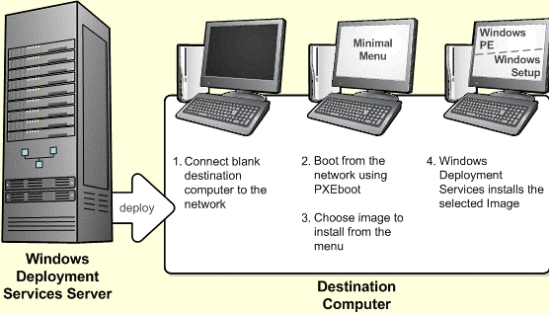
Using Windows Deployment Services

Slide 26
Server Activation
A valid product key is required
You need to activate your copy of Windows Server before the short activation period expires or else many functions of the operating system are disabled
Windows Server can be activated through the Internet or by telephone

Slide 27
Installing and Managing Service Packs
Service packs are designed to correct
security issues
problems affecting stability, performance, or the operation of features
Guidelines when installing the latest service packs
Download the latest service pack from Microsoft’s download site
Review the documentation that comes with the service pack before installing
Test updates before deploying

Slide 28
Installing and Managing Service Packs using WSUS
Personal or individual desktop computers obtain Service Packs and patches through Windows Update
Server Service Packs are usually managed by the system administrator and managed using a program like Windows Server Update Service (WSUS)
By using WSUS, administrators can fully manage the distribution of updates that are released through Microsoft Update to computers in their network.

Slide 29
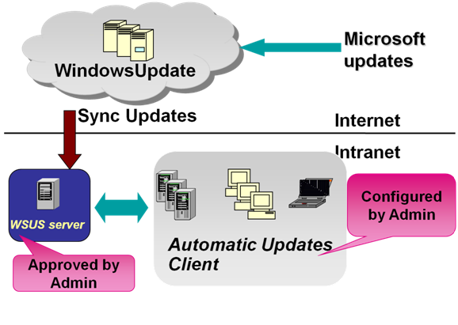
Installing and Managing Service Packs using WSUS

Slide 30
Troubleshooting Installation Problems
Keep the following points in mind to avoid problems:
Ensure that the hardware has the Certified for Windows Server sticker or is in the Windows Server Catalog of Tested Products
Test all hardware before installing the operating system
Run the computer manufacturer’s diagnostics before installing the operating system
Run a comprehensive test of the hard disk to ensure it is functioning properly

Slide 31
Uninstalling Windows Server
There is NO uninstall program for Windows Server
Format the partition where Server is installed
If you are installing another operating system you are given an opportunity to format the partition for the new operating system
FDISK and FORMAT utilities
DISKPART utility

Slide 32
Summary
complete pre-installation tasks to ensure the best result
Windows Server has many server roles, including Active Directory, DNS, DHCP, and file and print services
Windows Server can be installed using any of several methods, which include DVD installation, upgrading from previous versions of Windows Server, using Hyper-V for a virtual server, and WDS
perform basic configuration activities from the Server Manager
Windows Deployment Services can be used to save time and effort when installing multiple computers

Slide 33
Summary (continued)
Service packs should be installed to fix any known problems with the operating system
To uninstall Windows Server, use the installation of another operating system to overwrite the Windows Server installation or use tools such as FDISK, FORMAT, and DISKPART

